Slide 1
On-Device Prediction for Chronic Kidney Disease
Alex Whelan, Soham Phadke, Alessandro Bellofiore, and David C. Anastasiu
Notes:
Hi, my name is Alex Whelan. I am a PhD student at Santa Clara University in the Department of Computer Science and Engineering.
My research interests include Machine Learning and High Performance Computing.
Today I will be presenting our Paper “On-Device Prediction for Chronic Kidney Disease”

Slide 2
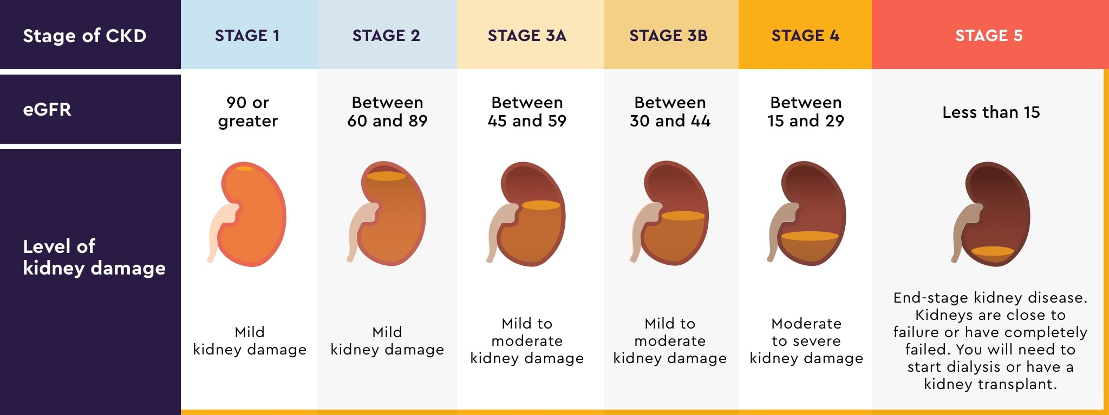
Chronic Kidney Disease (CKD)
Progressive decline of kidney function
Approximately 15% of US population affected by CKD
https://www.ckdandt2d.com/managing-chronic-kidney-disease
Notes:
Chronic kidney disease (CKD) means your kidneys are damaged and can’t filter blood the way they should.
In the early stages, your kidneys are still able to filter out waste from your blood. However, in the later stages, your kidneys must work harder to get rid of waste and may stop working altogether.
About 37 million people are estimated to have CKD
As many as 9 in 10 people affected by CKD and 2 in 5 people with severe CKD are oblivious to their condition.
Treatment options for severe and late stage diagnosis include regular dialysis treatment or kidney transplantation.

Slide 3
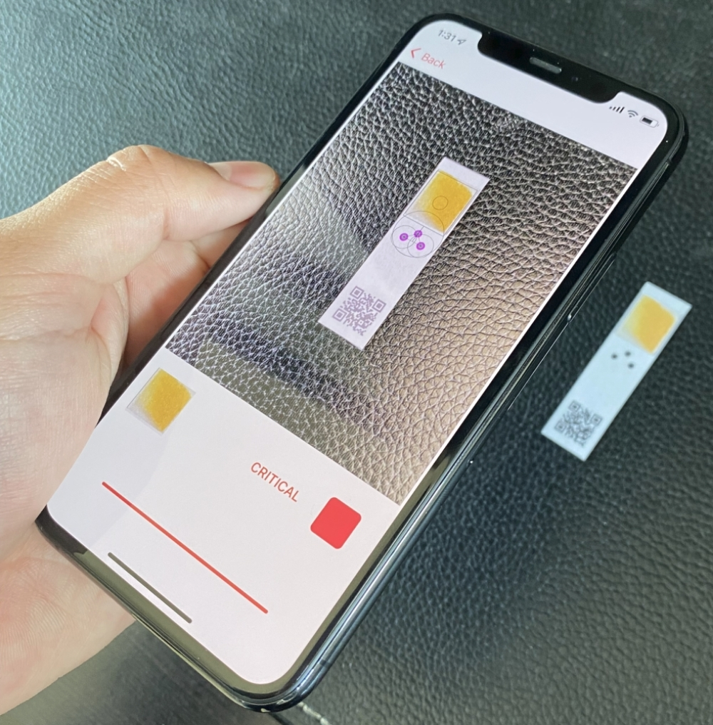
Point of Care Testing (PoCT)
Kidney Health Monitoring (KHM) System
Accessible
Fast & Reliable
Affordable
Humanitarian assistance
Alternative to LAB testing
Notes:
Our proposed solution is aims at offering continuous monitoring as a point of care testing service. Point-of-care (POC) testing involves performing a diagnostic test outside of a laboratory that produces a rapid and reliable result, aiding in identifying or managing chronic diseases and acute infections.
We designed a kidney health monitoring system that allows for affordable and quick testing through use of inexpensive test strips and a mobile application that we plan to offer free of charge once it is out of beta development.
Our proposed system Is an alternative to the expensive sensing devices that can enable humanitarian CKD testing in all parts of the globe.
Lastly, our goal is to offer the KHM application as a low-cost alternative to traditional lab testing which isn’t always accessible without a physician referral
In addition, Lab testing isn’t scalable to be offered as POCT.

Slide 4
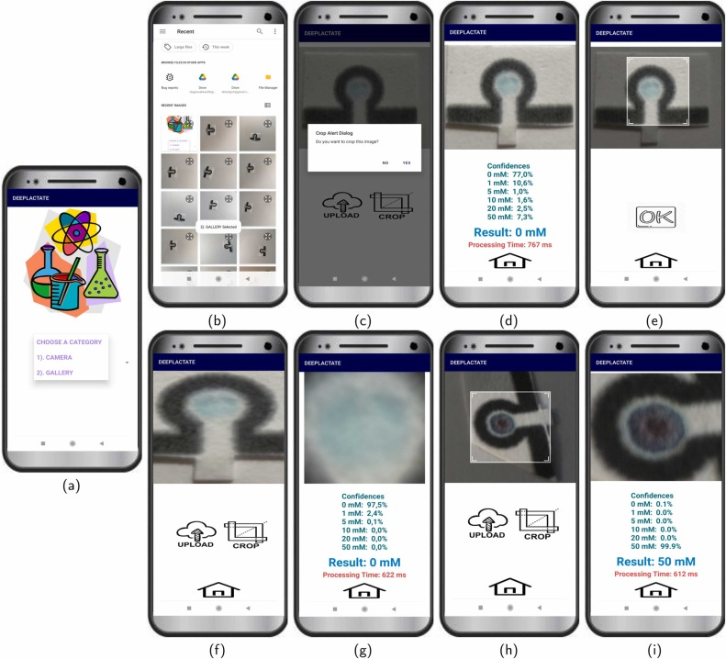
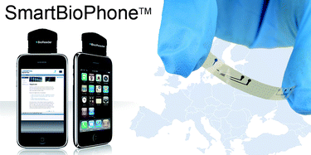
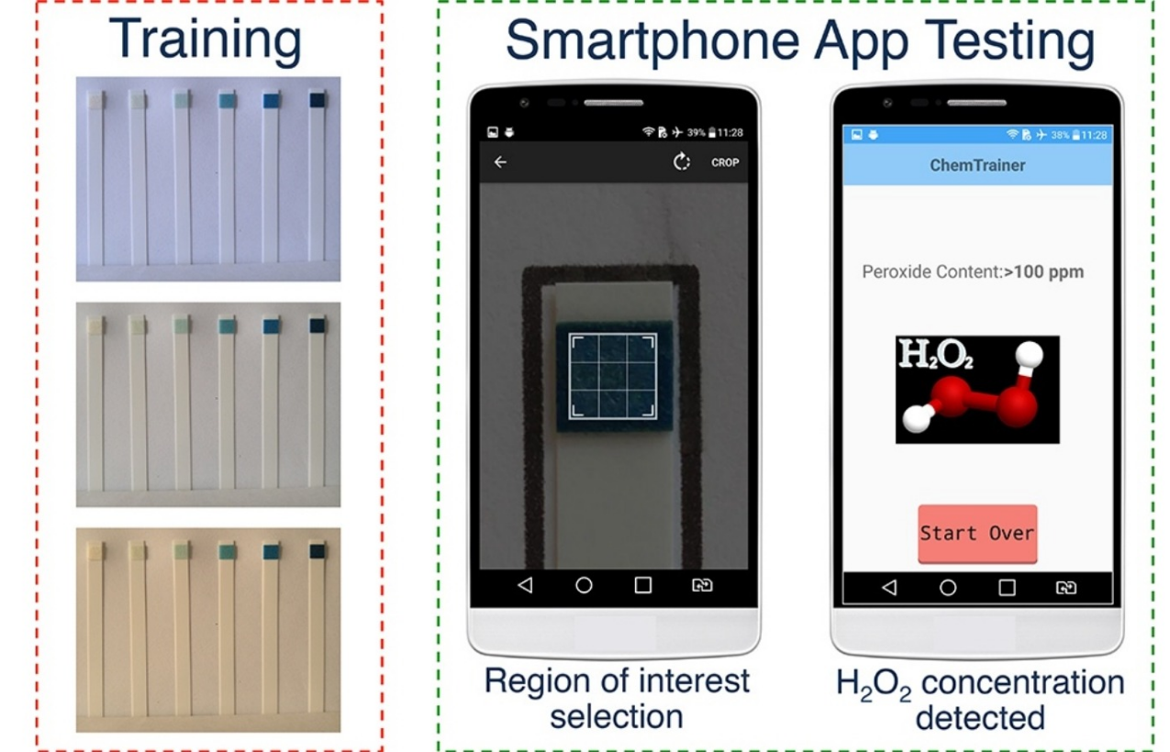
Related Works
DeepLactate : https://ars.els-cdn.com/content/image/1-s2.0-S0925400522011315-gr3.jpg
SmartBioPhone [1]
ChemTrainer [2]
DeepLactate [3]
SmartBioPhone : https://pubs.rsc.org/en/Image/Get?imageInfo.ImageType=GA&imageInfo.ImageIdentifier.ManuscriptID=B902354M&imageInfo.ImageIdentifier.Year=2009
ChemTrainer : https://ars.els-cdn.com/content/image/1-s2.0-S0925400517316519-fx1.jpg
Notes:
SmartBioPhone, is a European Union industrial collaborative project, that aims to bring smart phone-based point-of-care testing using Lab-on-a-Chip (LOCs) devices to environment, food, cancer and drug monitoring applications.
Chemtrainer is a smartphone application based on machine learning classifier algorithms that was developed for quantifying peroxide content on colorimetric test strips.
DeepLactate is another application developed for mobile that uses DeepLearning CNN networks like VGG, ResNet, Inception, Xception, and MobileNet to predict lactate concentration in sweat.
The latter two aren’t specific to CKD. However, they are in the same problem domain of colorimetric change in relationship with a concentration of a substance.

Slide 5
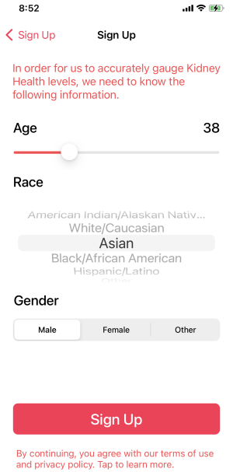
Application Setup
[Sign up]
Modes of Operation
User
Researcher
Notes:
We designed our application to be used in two different modes of operation.
In user mode, the application uses the latest and best model to generate predictions and stores the user’s readings over time.
In research mode, a scientist can run one or more experiments using different meta-parameters (e.g. prediction model, augmentation technique, feature extraction method)

Slide 6
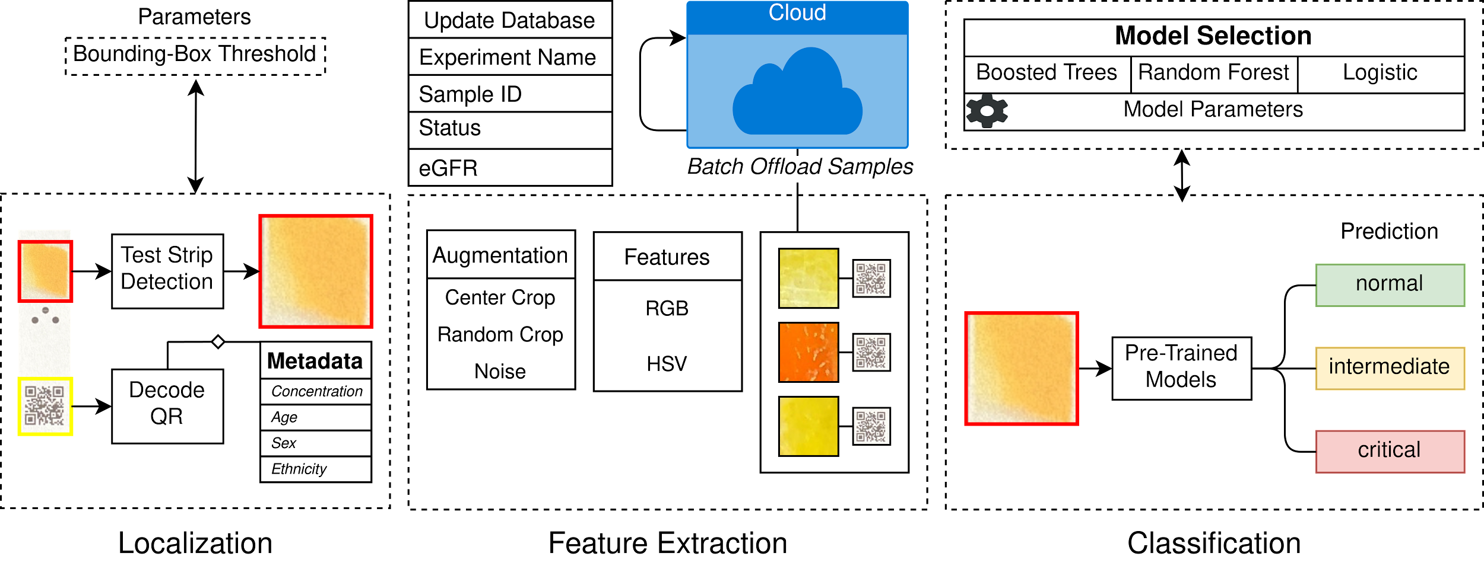
Application Workflow
Notes:
Methods
The entire best end-to-end model is able to go through this pipeline within 1 second which facilitates future testing and data acquisition (may vary on the feature-extraction methods and augmentation).

Slide 7
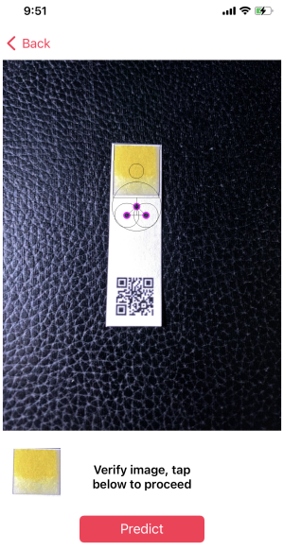
Localization
Hough Circle Transform Method
Decode Metadata
Notes:
[Localization]
Our simulated teststrip consists of a printed creatinine concentration, followed by three dots representing an isosceles triangle, which is used by the Hough Circle Transform method, in assisting in the detection of our region of interest.
The QR code is used for encoding the samples’ associated age, sex, and ethnicity and the ground truth values for the creatinine concentration. These metadata values are used in our final classification step.

Slide 8
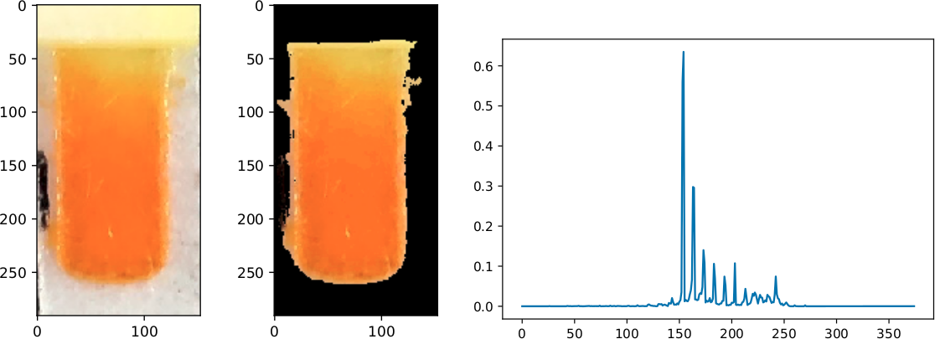
Feature Extraction
HSV Feature Vector Construction (bottom)
Randomized Crop (right)
Dimensionality Reduction
Notes:
[Feature Extraction]
In our work, we tested two different feature extraction techniques, one based on the standard red-green-blue (RGB) color space, and the other based on the hue-saturation-value (HSV) color space.
For RGB our feature vector is simply a concatenated channel-wise representation of the image.
For HSV the feature vector is constructed from a binned color histogram of pixels masked with a specific hue and saturation range as you can see in the image below.
This also serves as a dimensionality reduction technique by reducing the size of our feature vector.
The image on the right is our implementation of random crop which is centralized around the center of the teststrip where the chemical reaction occurs most prominently.
This augmentation technique becomes extremely important when working with DeepLearning models because it helps with overfitting and the model generalizes better to unseen data.

Slide 9
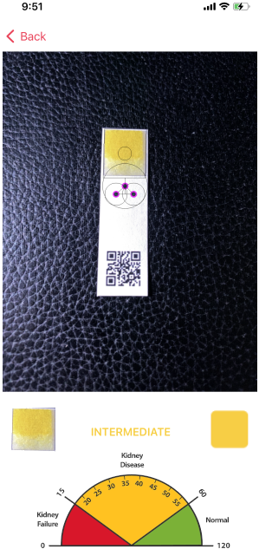
Classification
Predictions using eGFR and metadata
Update Models in Cloud Database
Notes:
[Classification]
The application then outputs the predicted CKD status and the associated eGFR value.
In addition, the readings and captured samples are offloaded into a FireStore Database where the newly collected data is used to train and update the existing models.

Slide 10
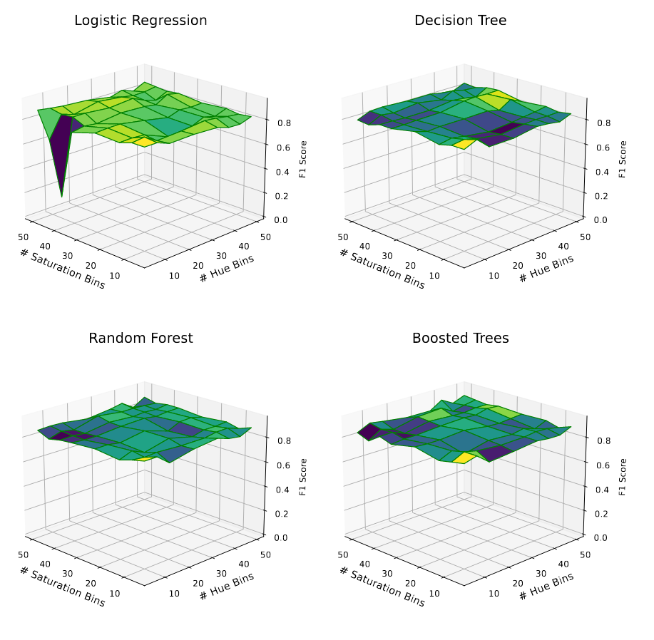
Evaluation
10-Fold Cross-Validation
F1 evaluation metric
Gridsearch (right)
Notes:
We trained 4 models provided by AppleML’s framework splitting our data in a 70:5:20 train/validation/test split ratio with stratified sampling on the CKD status and performing 10-Fold CV.
The model effectiveness was measured using F1 score, which is the harmonic mean between the precision and recall.
In addition, we performed a gridsearch to find the optimal bin parameters for the model using HSV features.

Slide 11
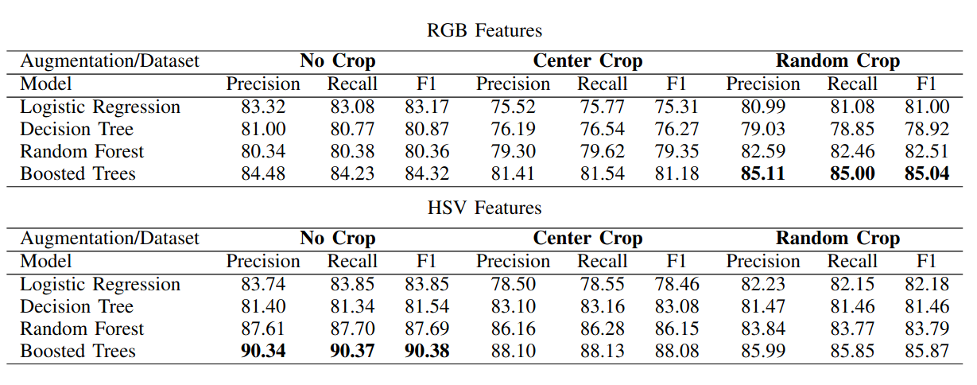
Model Effectiveness
Notes:
Our feature engineering method outperforms simply using RGB values as features.
Our best model is able to achieve an F1 score of over 90 percent using the fine-tuned AppleML’s Boosted Tree implementation.

Slide 12
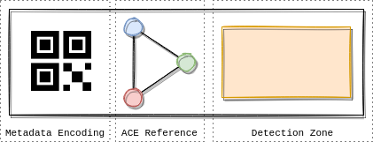
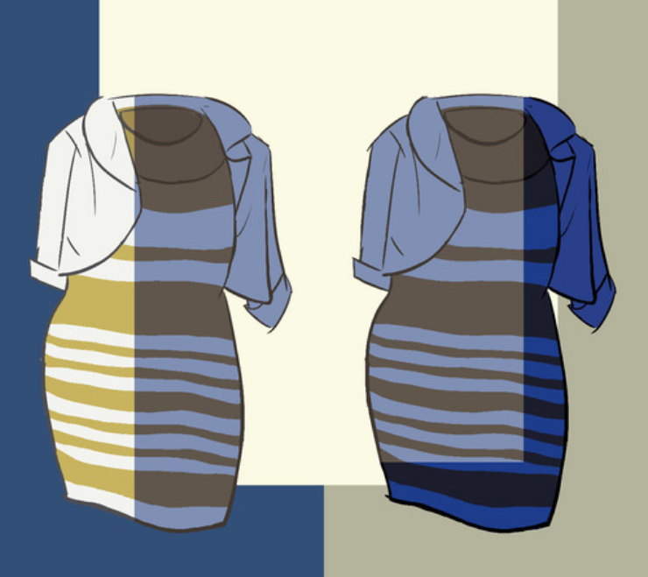
Future Work
Concept Teststrip Design
Deep Learning Model
Color Constancy
Resolving Artifacts
Color Constancy : http://pillowlab.princeton.edu/teaching/sp2015/slides/Lec11_ColorConstancy_Chap5c.pdf
Notes:
The ubiquity of deep learning models for solving similar problems necessitates us to explore more of this domain.
Samples taken in real-world lighting conditions will make model performance worse if we don’t account for the unknown light source values. Automatic Color Equalization techniques allow us to address color constancy in a variety of ways.
angularGAN is a new revolutionary method for removing artifacts, shadows, blurring, and it also handles color constancy.

Slide 13
Questions?

Slide 14
Citations
[1] J. M. Ruano-Lopez, M. Agirregabiria, G. Olabarria, D. Verdoy, D. D. Bang, M. Bu, A. Wolff, A. Voigt, J. A. Dziuban, R. Walczak, and J. Berganzo, “The smartbiophone™ , a point of care vision under development through two european projects: Optolabcard and labonfoil,” Lab Chip, vol. 9, pp. 1495–1499, 2009.
[2] M. E. Solmaz, A. Y. Mutlu, G. Alankus, V. Kılıc ̧, A. Bayram, and N. Horzum, “Quantifying colorimetric tests using a smartphone app based on machine learning classifiers,” Sensors and Actuators B: Chemical, vol. 255, pp. 1967–1973, 2018. [Online]. Available: https://www.sciencedirect.com/science/article/pii/S0925400517316519
[3] E. Y ̈uzer, V. Do ̆gan, V. Kılıc ̧, and M. S ̧ en, “Smartphone embedded deep learning approach for highly accurate and automated colorimetric lactate analysis in sweat,” Sensors and Actuators B: Chemical, vol. 371, p. 132489, 2022. [Online]. Available: www.sciencedirect.com/science/article/pii/S0925400522011315
[4] O. Sidorov, “Conditional gans for multi-illuminant color constancy: Revolution or yet another approach?” in Proceedings of the IEEE/CVF Conference on Computer Vision and Pattern Recognition (CVPR) Workshops, June 2019.

